Slide 1
Remote Visual Expert

Slide 2
Revix: Remote Visual Expert
Revix is ​a remote technical support software designed to offer assistance to staff working off-site through the help of the experts of a central technical call center.
Revix can be used in different/various operational situations and towards equipment which it is impossible to connect remotely to take their control and reconfigure them as it usually happens towards computers connected to the network.
Some service work requires manual operations and manual procedures made by the technician arrived on site such adjustments, dismantling, wiring, measurements, inspections of equipment impossible to connect to the network, or remotely use such as: engines, cards, cables, paintings tools, equipment, mechanical parts, etc.
A specialist on your side
How many times a technician, when in difficulties in a technical intervention , would need the presence of a skilled specialist at his side , who could assist and help him in solving problems?
Sometimes the place where the assistance intervention has to take place is very far from the central location and it would be useful to have someone on site who can solve in real time any kind of issue, even with minimal technical know how, if adequately supported.
In other circumstances a technician has been sent to the customer to solve a problem which turned out to be an easy issue, or the specialized intervention required by the customer did not coincide with the real / correct reason of the issue.
The technician who has been sent there could not have the needed competences to solve the problem, so a further intervention would be needed, and the travel costs plus intervention costs would be doubled, and the recovery rates and time would be extended.
With Revix you can have at your disposal a remote support instrument which will allows you to virtually sustain the operating technician and
help him to solve the problem.

Slide 3
How does Revix work?
In order to use Revix you need:
Smartphone or traditional tablet with installed APP Revix disposable to the technician
Revix software installed on the Technical assistance center Pcs
Internet connection (Wi-Fi, LTE, 3G)
Through the Revix App the technician makes a videocall VoIP towards the service centre in order to get in touch with the local operators.
Revix allows to the service centre specialists to “look at” the problem with the technician’ eyes who is on site and allows to guide him step by step towards the problem solving…. But that’s not all!!!
In fact the technician, besides connected by VoIP with the Service centre, by framing with the device the actual situation which represents the issue, is able to remotely receive the info supplied by the service centre (augmented reality).
The overlapping of graphical virtual elements over the “sight” of the technician, helps him to easily understanding the needed operations to be made.
The Service centre is able to even share wiring diagrams, reference manual, images and details.
All of this info will allow to the technician the most easy and fast resolution of the problem.
Revix: how technology can change our work
approach

Slide 4
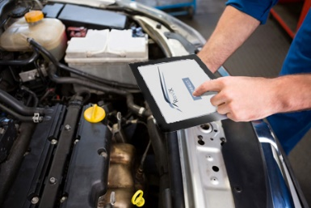
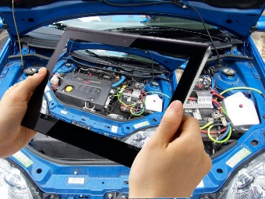
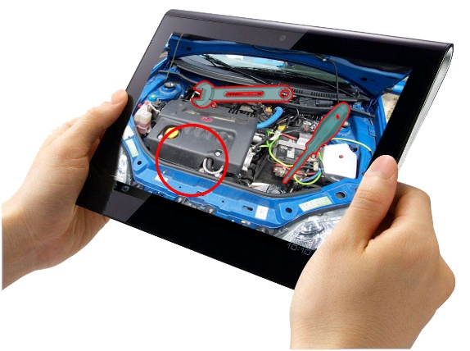
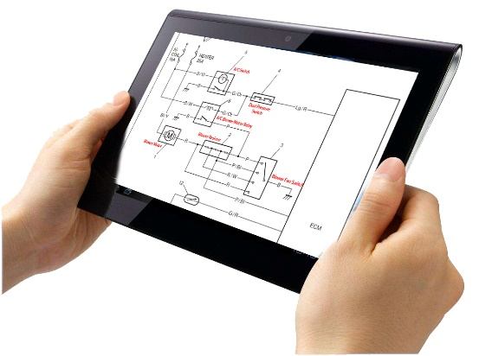
Conditions of use
The technician connects to the Service centre through Revix App
The technician, by using Revix is connected through VoIP - “audio – video” with the Service centre which looks over the problematic situation.
The Service centre guides the technician to the problem resolution by using graphical elements in “augmented reality”, and sharing technical frames, handbooks, images and info concerngin the problem besides the call vocal support.
Thanks to the support of the Service centre specialists, the technician is able to easily and quickly solve the issue.

Slide 5
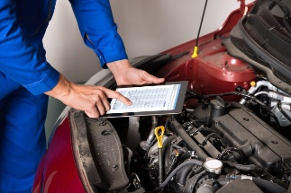
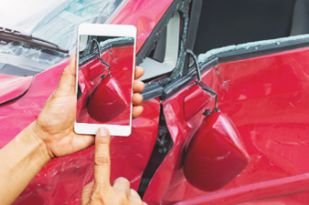
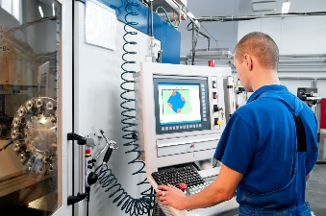
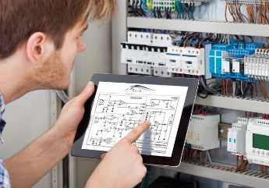
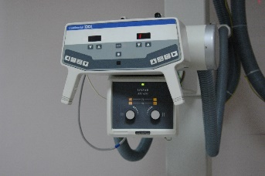
Some application area
Automotive – Car repairers:
Revix supports the car repairers through specific technical call center.
Insurance:
Revix support the car drivers in case of accident in the CID compilation and sending data through the support of the personal Insurance Agency
Industrial automation:
Revix support operators of production lines and machines for use, service / repair provided by the supplier. Revix can be integrated directly into the machine operator panel.
Repair sector:
Revix support provided to assistance from the central office technicians to repair, wiring, installation and during all repair operations of equipment.
Information Technology:
Revix supports the technical staff during all manual operations, assembly, mechanical or wiring, installation and dismantling of computer equipment.
Medical sector:
Revix support to patients for remote screening or first contact with your doctor via telephone when a symptomatic description is not enough to understand the problem.
Electromedical:
Revix support to technicians carrying out repairs at hospitals or medical institutions and private when, in your own home, have maintenance or emergency repair to be performed on the acquired medical equipment.

Slide 6
Benefits
Recent research indicates that the "visual information" are 430% more effective than only verbal communication and that the combination of visual and verbal elements makes the same message 10 times more effective and easily understandable.
Source: British Journal of Clinical Psychology
Increased efficiency
It eliminates 18% of cases where it is necessary a second operation assistance due to lack of experience of the technical staff sent.
It reduces by 19% the possibility of further action due to lack of information.
It prevents about 28% of the need for further action due to misdiagnosis.
Increased efficiency
Benefits for the service provider
Reduce the time of the single intervention, more efficient and therefore more time to do other interventions.
Reduction of the single intervention costs.
They disclose essential information if required to solve the problem.
The "know-how" is maintained without having to train others.
Reduced periods of training on topics that perhaps will never be used.
Optimization of experienced staff being able to "virtually transfer."
Reduced costs for the transfer from one site to experienced staff.
Benefits for the user of Customer Service
Increased perception of service quality.
Reduction in the intervention time.
Reduction of in-depth training and refresher courses.
Support real-time during surgery.

Slide 7
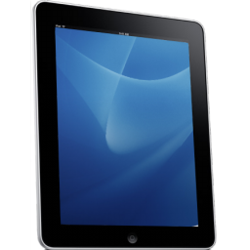
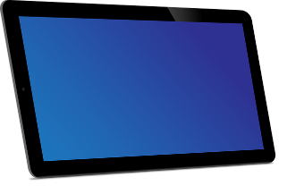
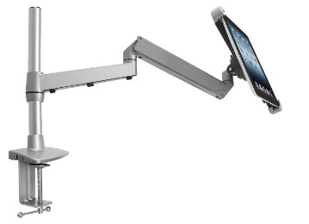
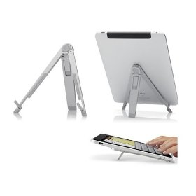
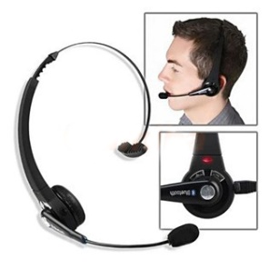
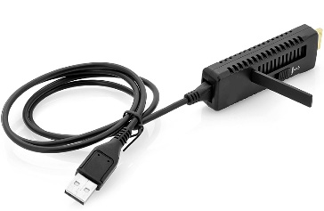
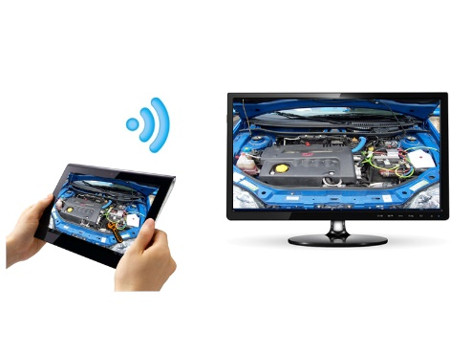
Accessories
Upon request we are able to provide Tablet configured with pre-installed App Revix according to your needs.
Support arm and table for tablet
Headsets 'handsfree' bluetooth
WI-FI TV HDMI Miracast adapter to transmit images from tablet to TV

Slide 8
Custom developments
Revix Software Integration
Revix can be integrated into the systems already in use by the customer.
Revix can be used in stand alone mode or integrated with programs such as DBMS, Management Programs, Incoming Call Software, Customer Relationship Management.
Revix Additional Tools
Each situation has unique characteristics. Each client has needs that are different operating procedures and service delivery.
Revix can be extended in its functionality according to the customer with unique customizations, adapted to carry out the work according to the real operational needs.
Following a feasibility study and analysis Revix can grow and increase in performance that will facilitate your work.
Rand Solutions

